Slide 1
Sign of the Week
From September 2023

Slide 2
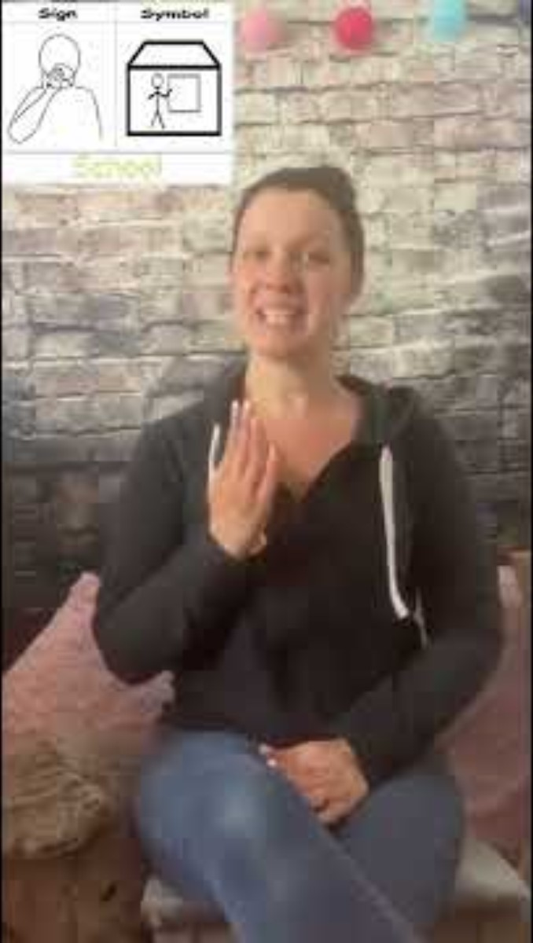
W/B 05.09.23 - School

Slide 3
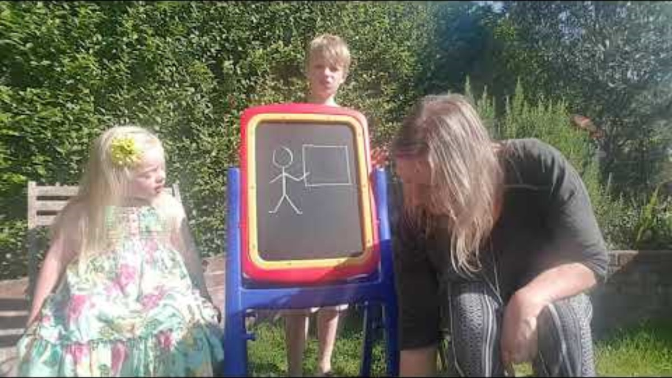
W/B 11.09.23 - Teacher

Slide 4
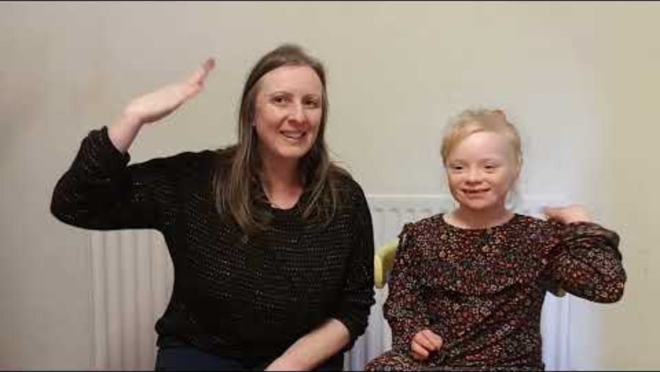
W/B 18.09.23 - Wind

Slide 5
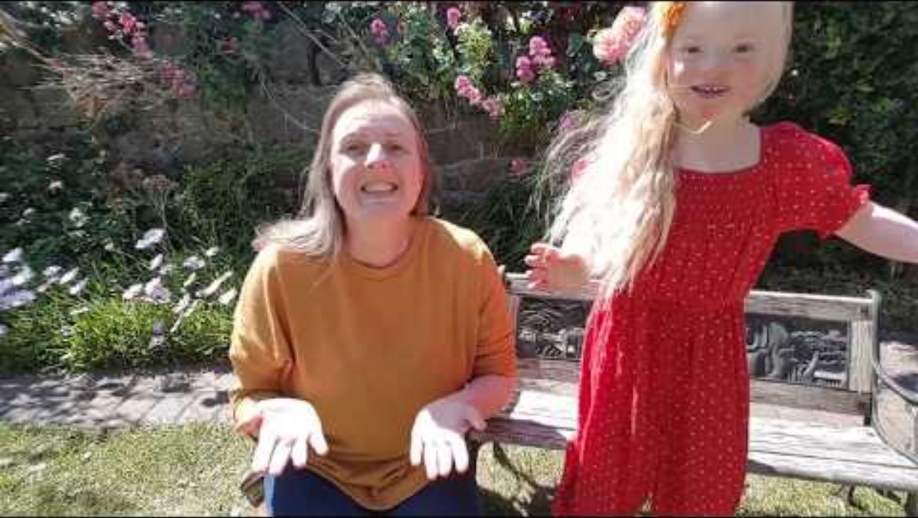
W/B 25.09.23 - Kind

Slide 6
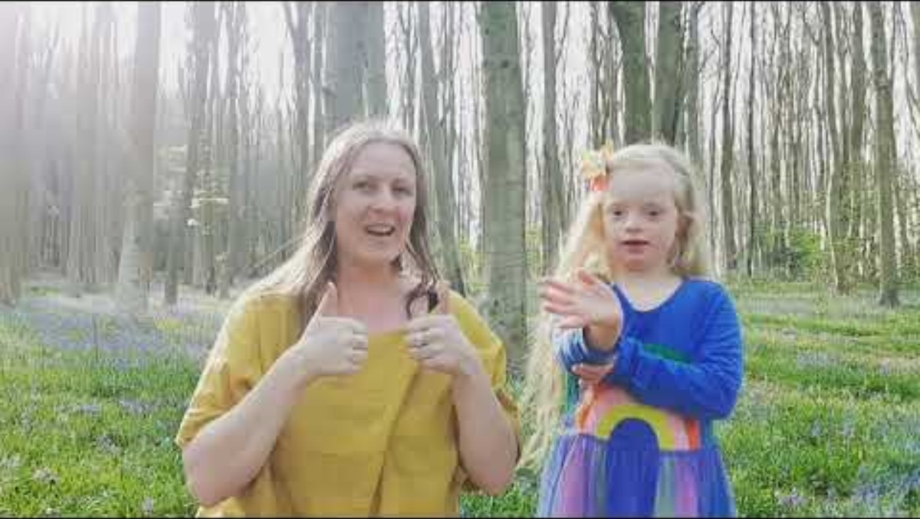
W/B 02.10.23 - Tree

Slide 7
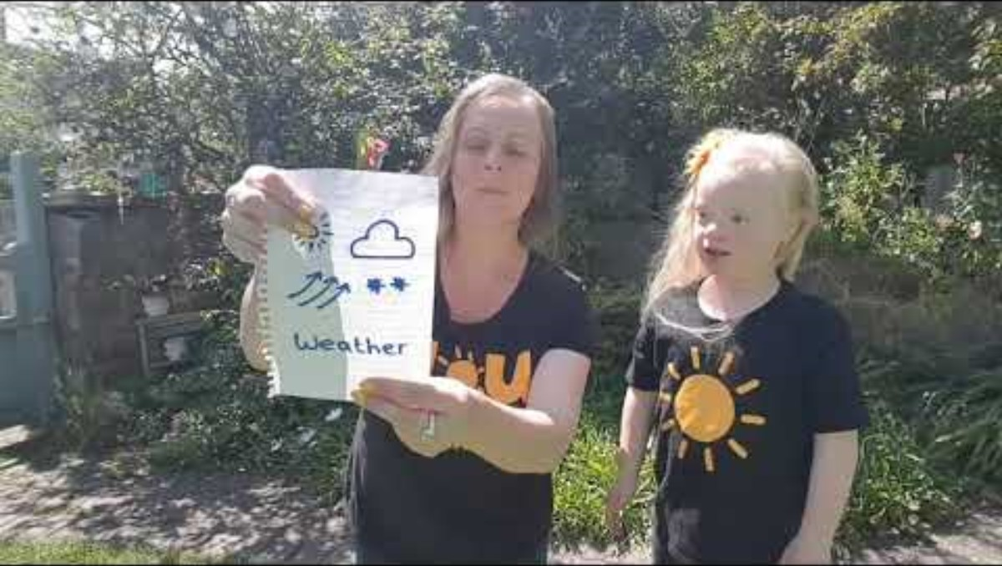
W/B 09.10.23 - Weather

Slide 8
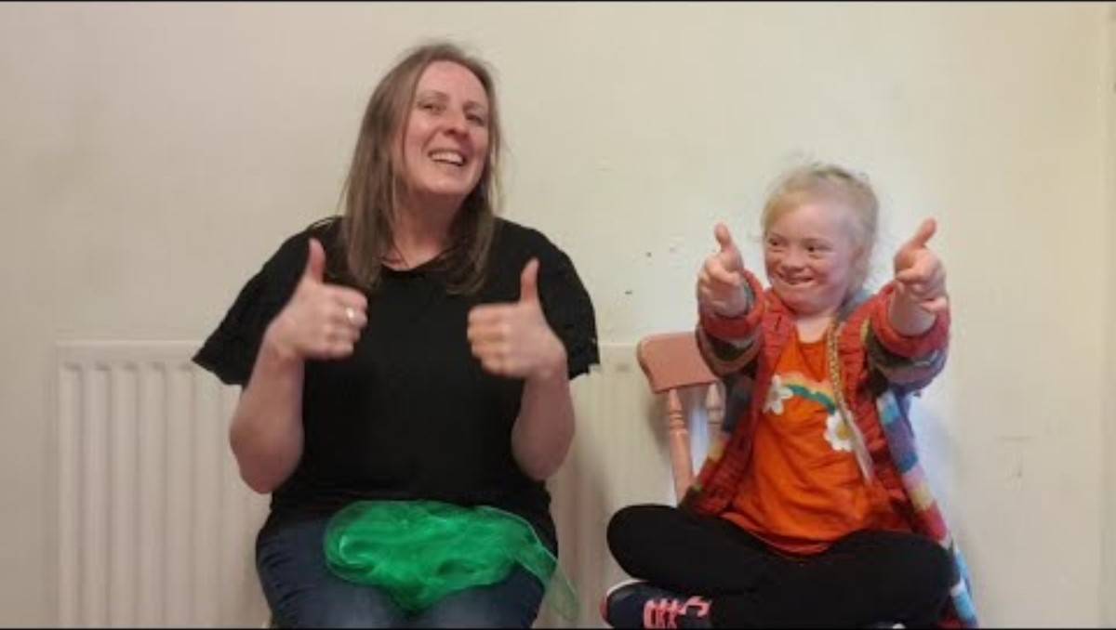
W/B 16.10.23 - Green

Slide 9
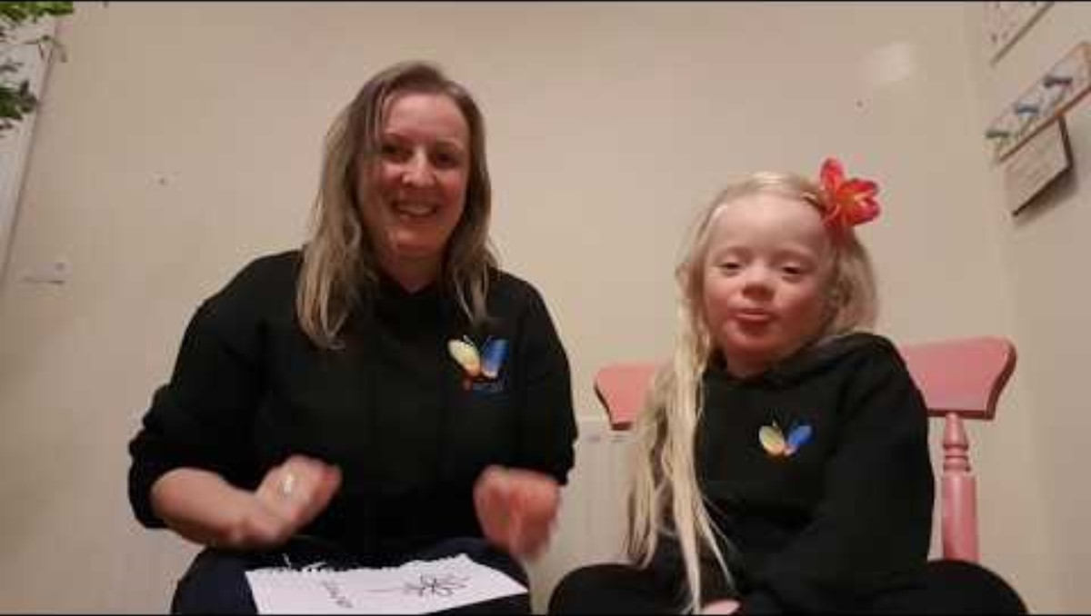
W/B 30.10.23 - Flowers

Slide 10
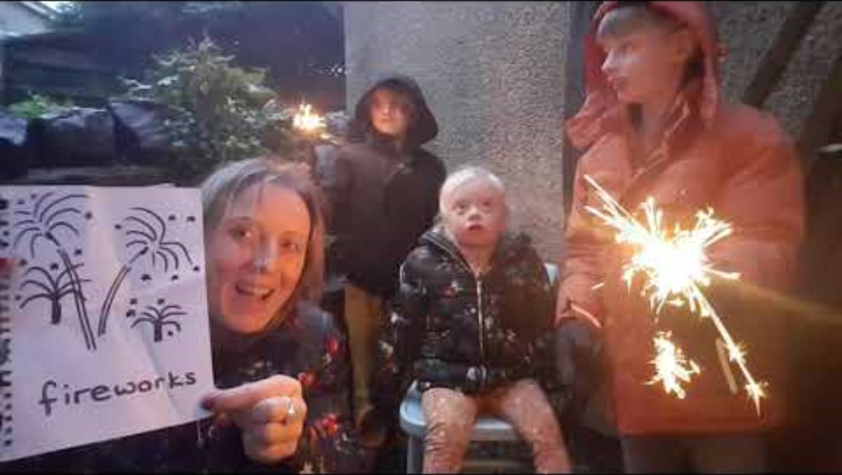
W/B 06.11.23 - Fireworks

Slide 12
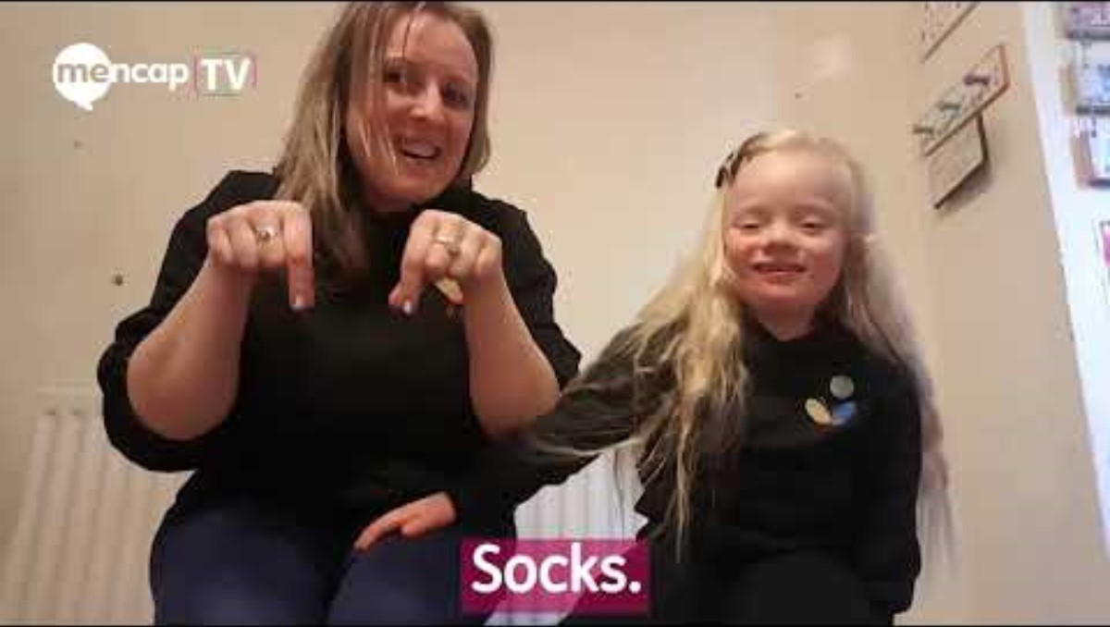
W/B 13.11.23 - Socks (for Anti-bullying week)

Slide 13
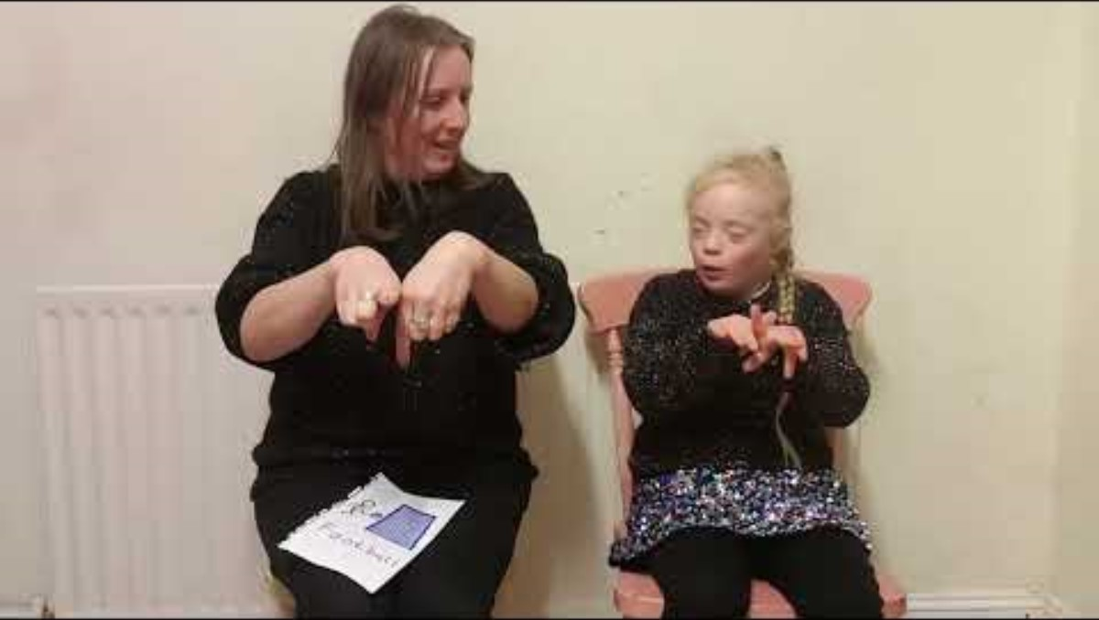
W/B 20.11.23 - Football

Slide 14
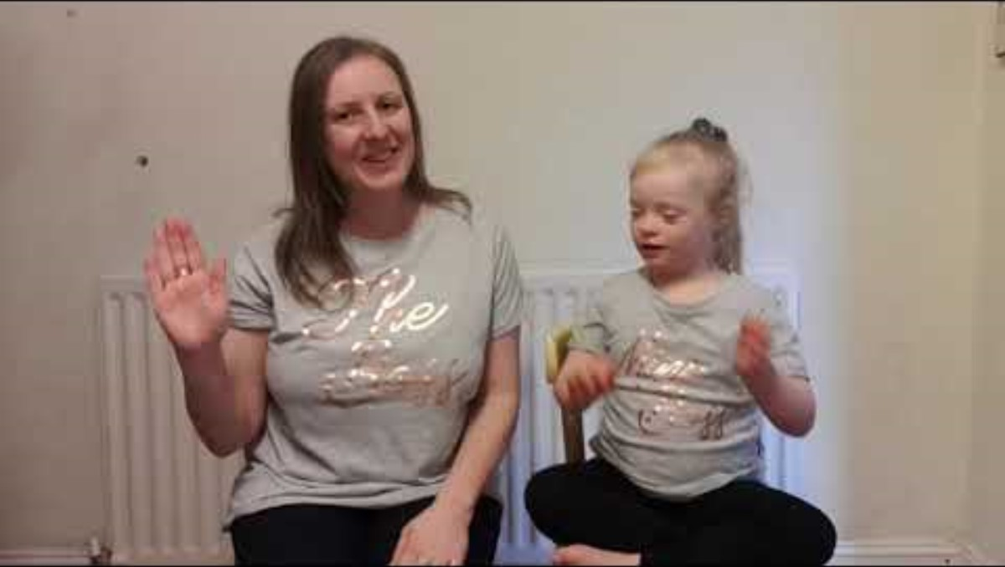
W/B 27.11.23 - To Work

Slide 15

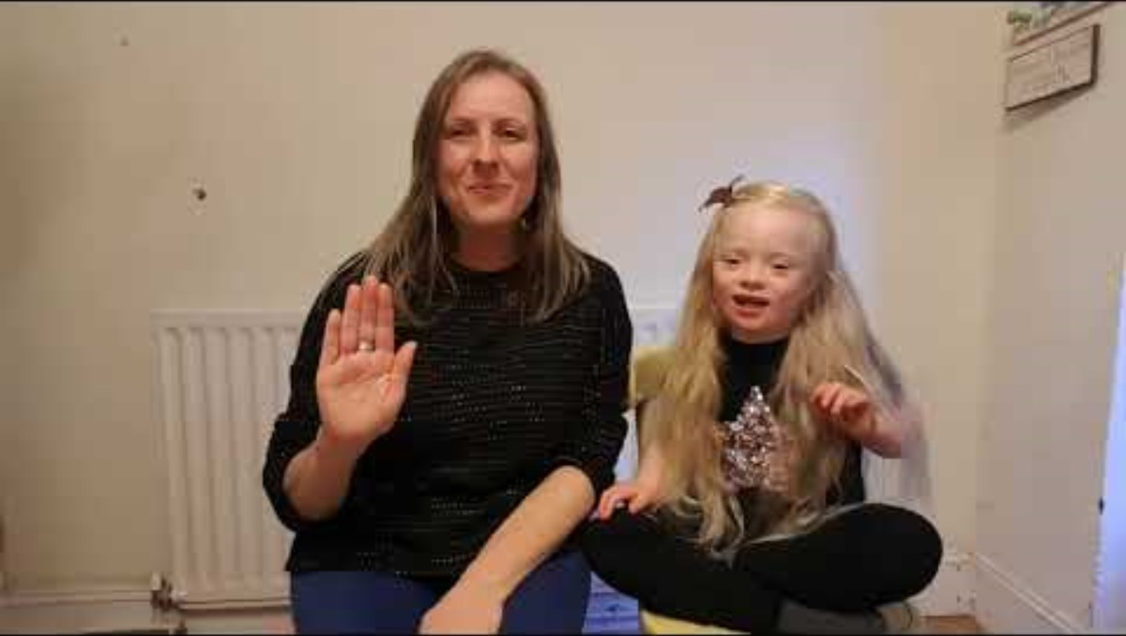
W/B 04.12.23 - Good morning

Slide 16
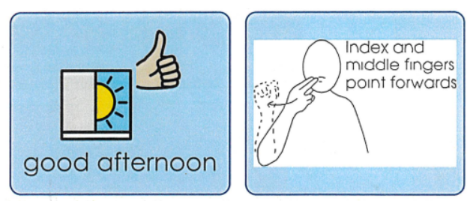
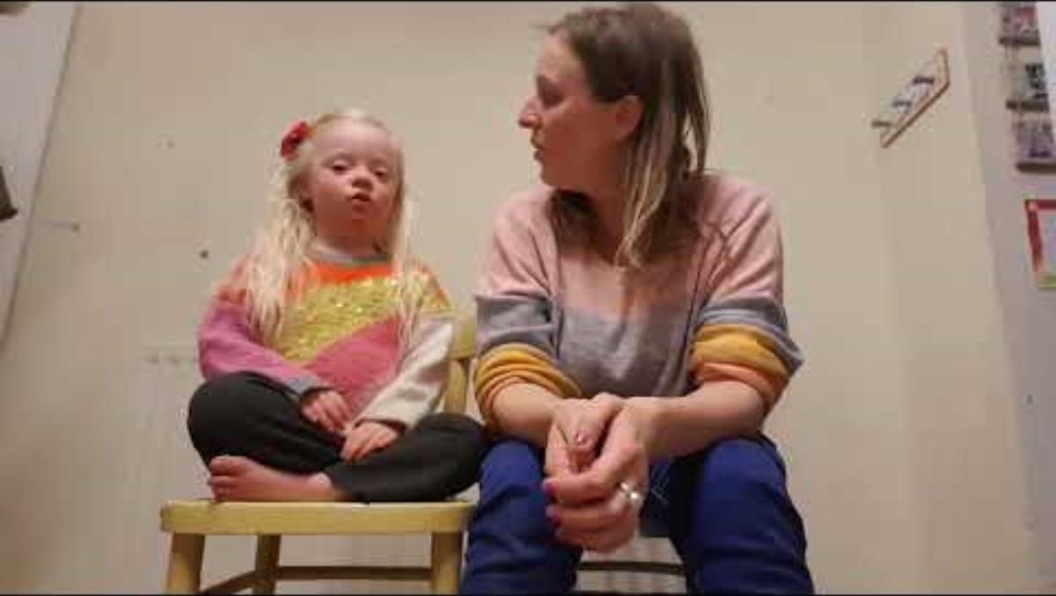
W/B 11.12.23 - Good afternoon

Slide 17
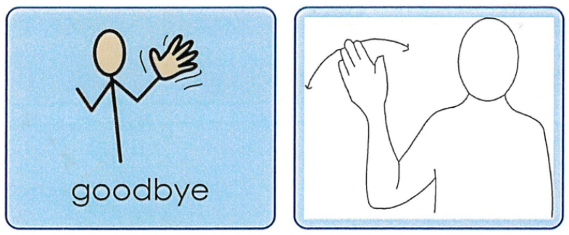
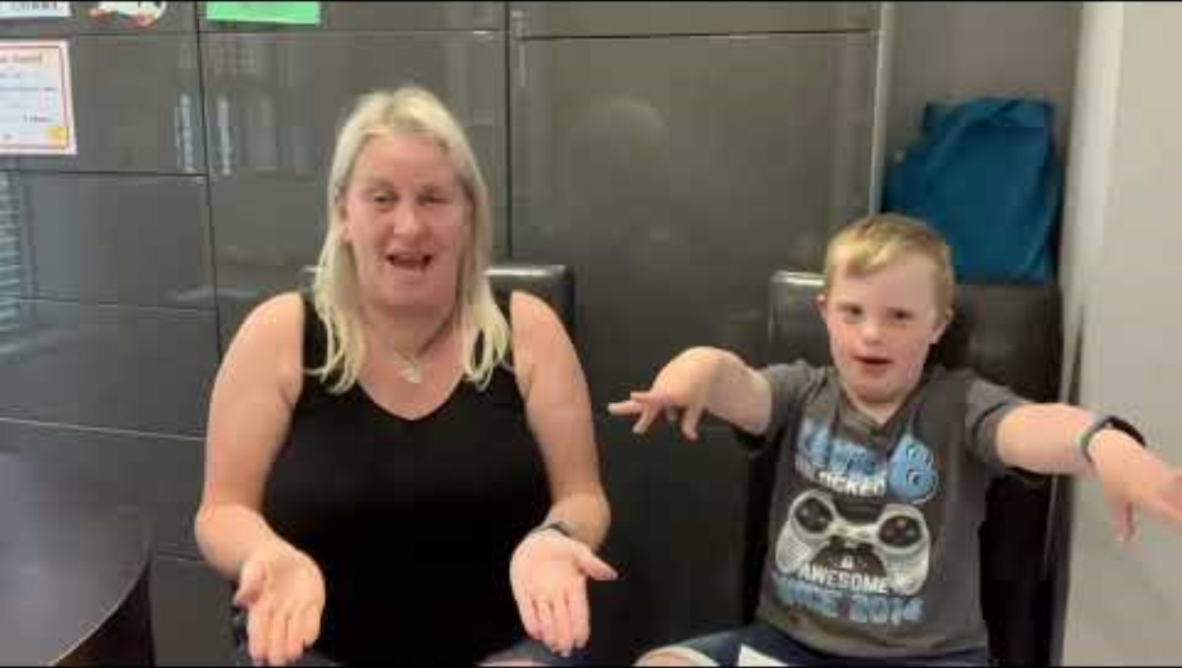
W/B 01.01.24 - Goodbye

Slide 18
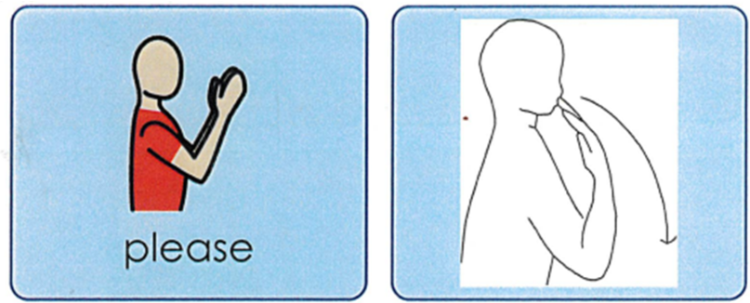
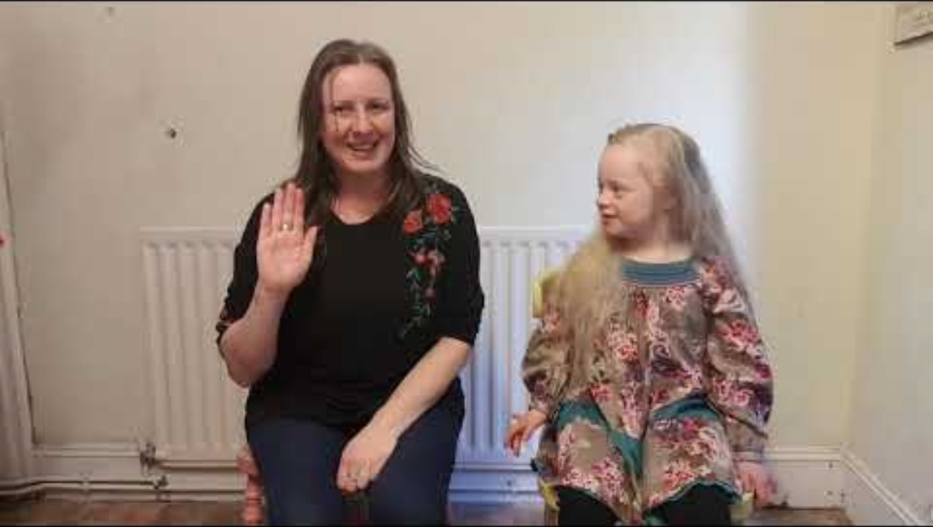
W/B 08.01.24 - Please

Slide 19

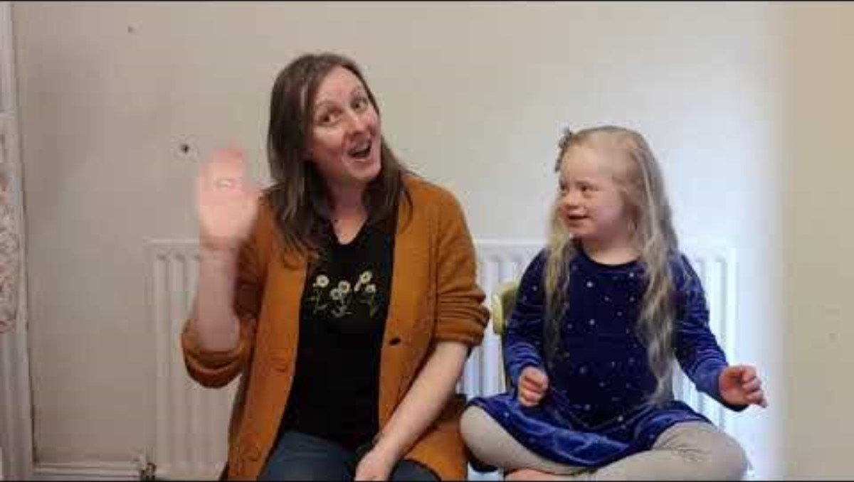
W/B 15.01.24 - Thank you

Slide 20
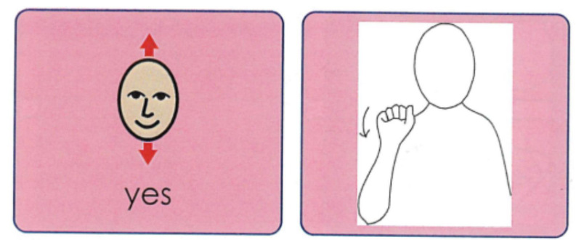
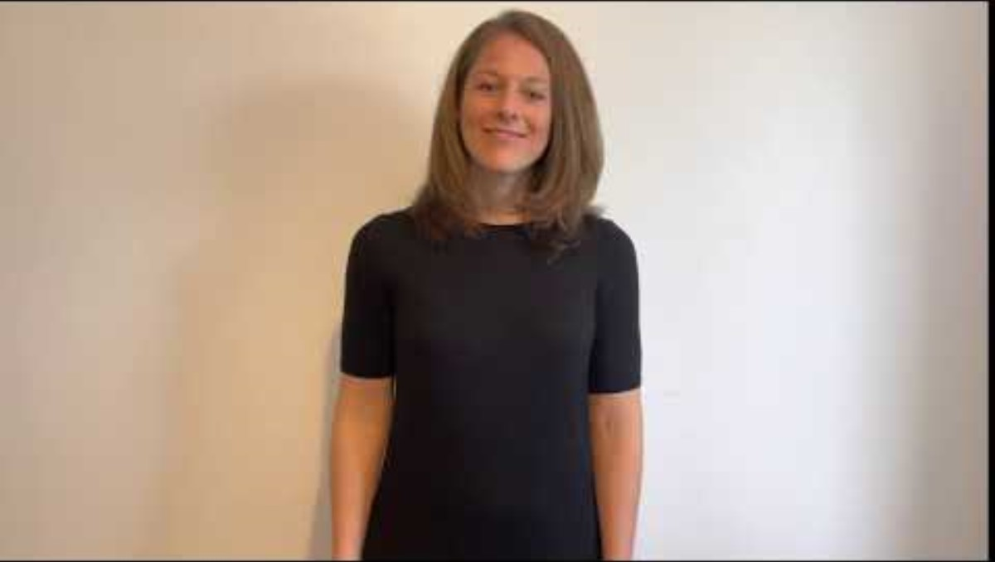
W/B 22.01.24 - Yes

Slide 21

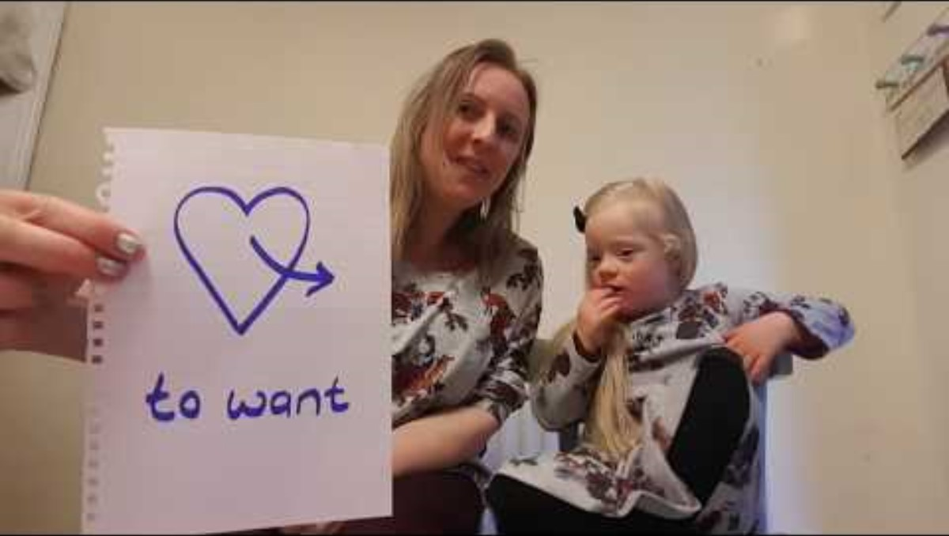
W/B 29.01.24 - Want

Slide 22
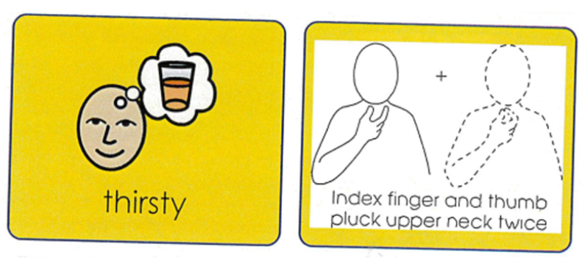
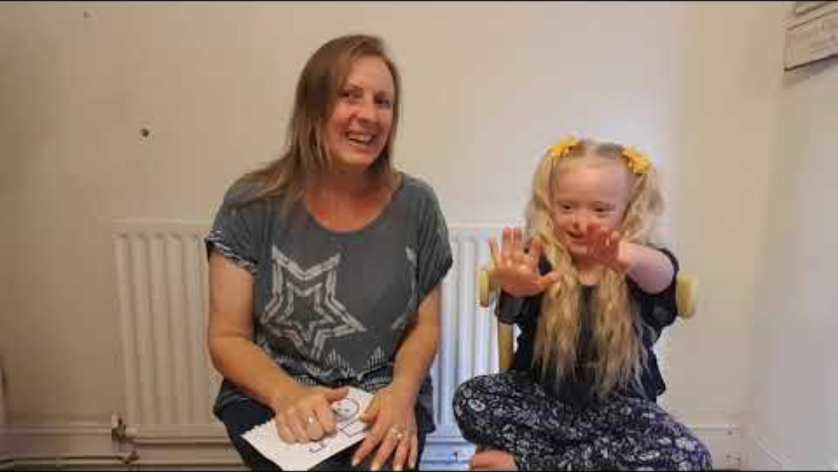
W/B 05.02.24 - Thirsty

Slide 23
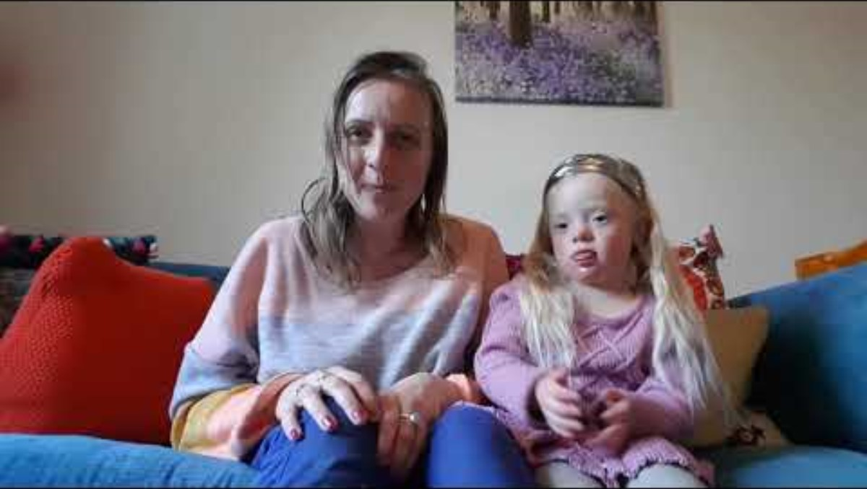
W/B 19.02.24 - Stop

Slide 24
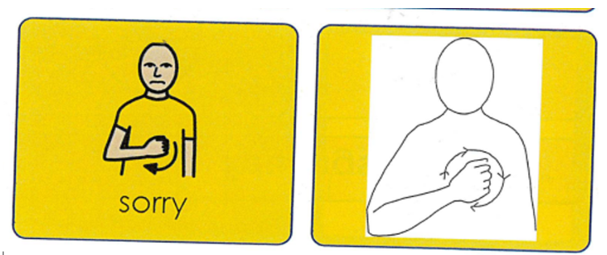
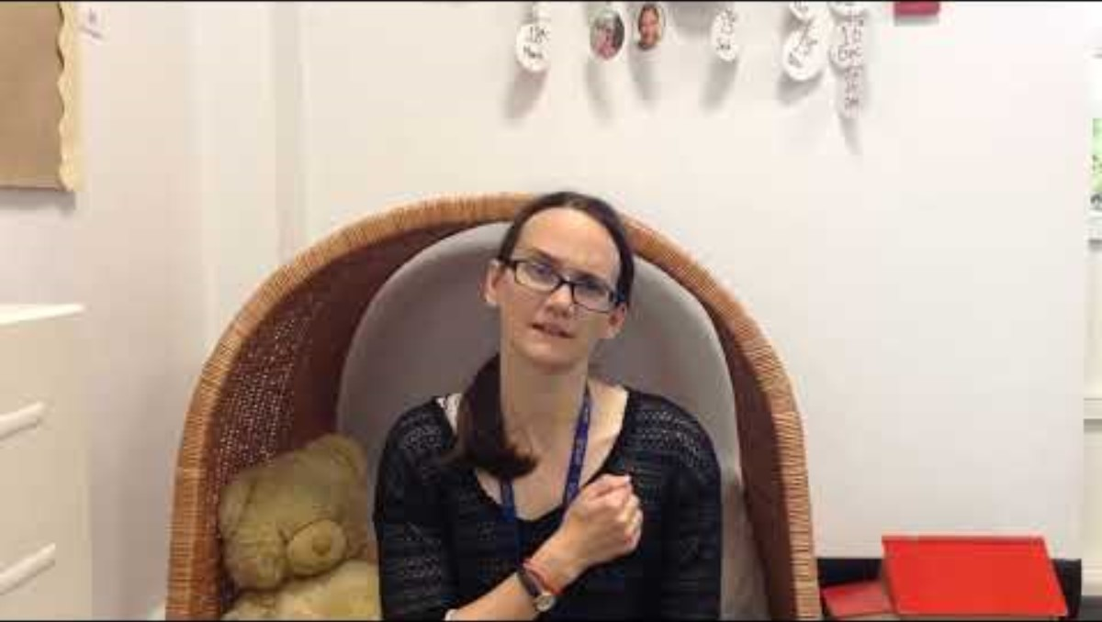
W/B 26.02.24 - Sorry

Slide 25
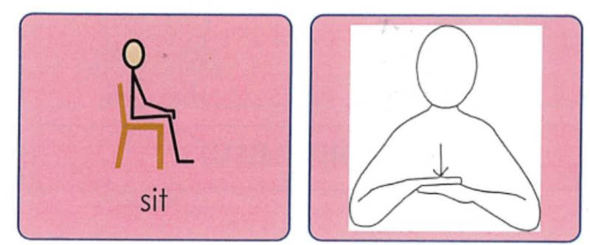
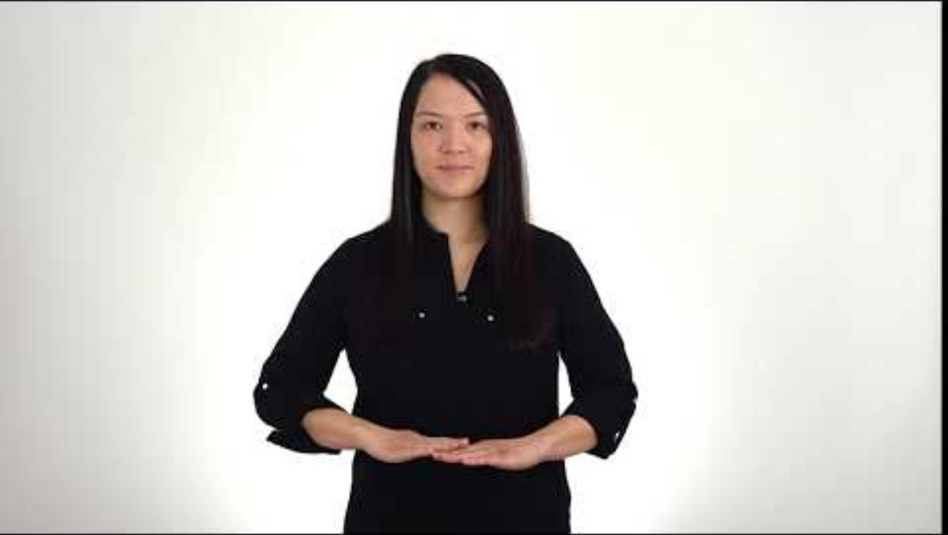
W/B 04.03.24 - Sit

Slide 26
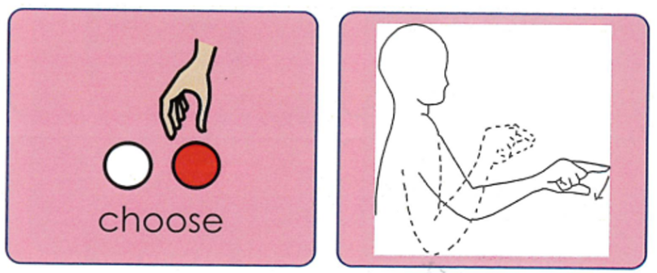
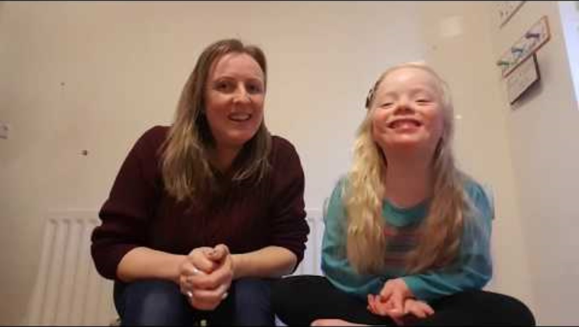
W/B 11.03.24 - Choose

Slide 27
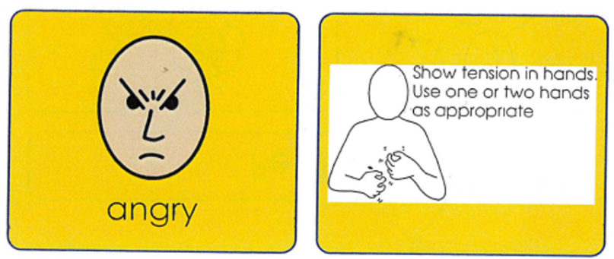
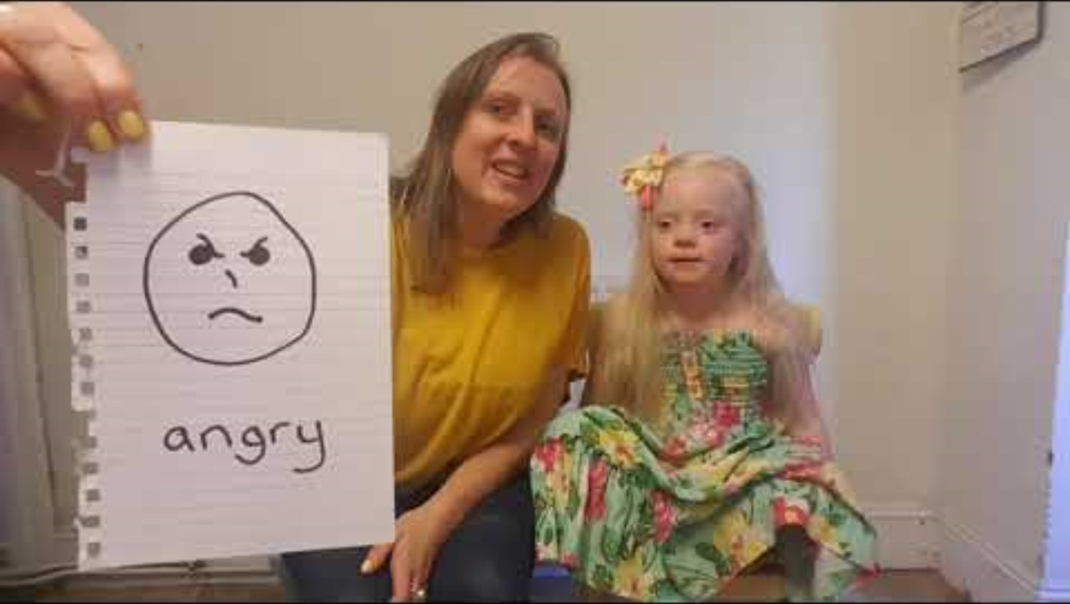
W/B 18.03.24 - Angry

Slide 28
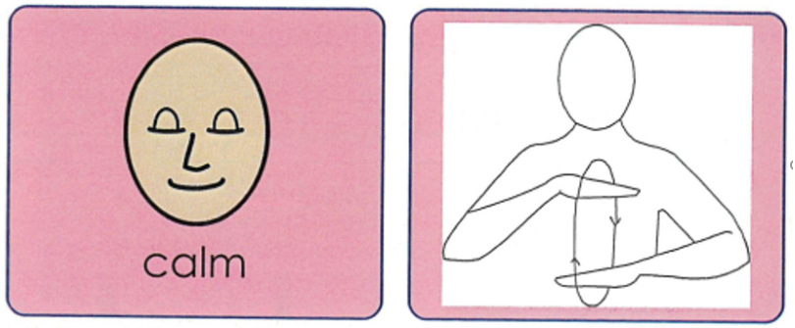
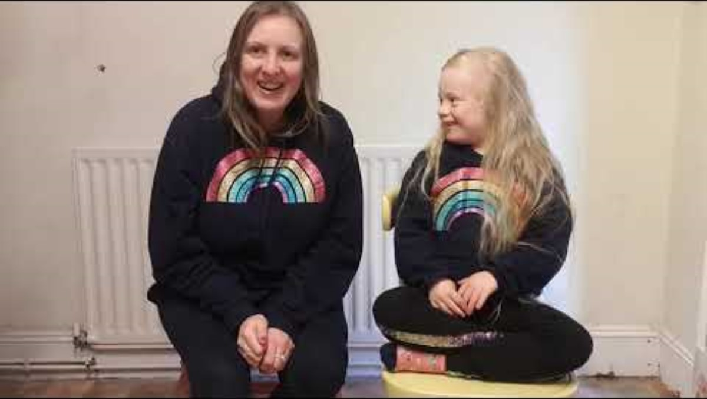
W/B 25.03.24 - Calm

Slide 29
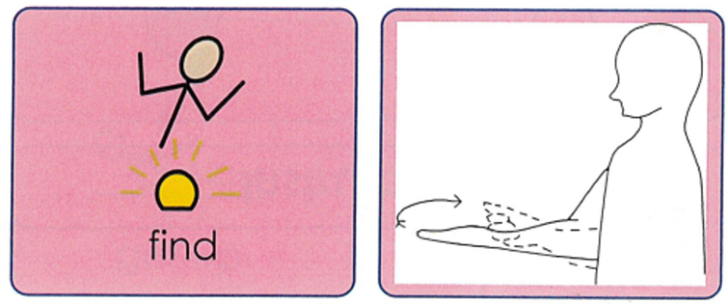
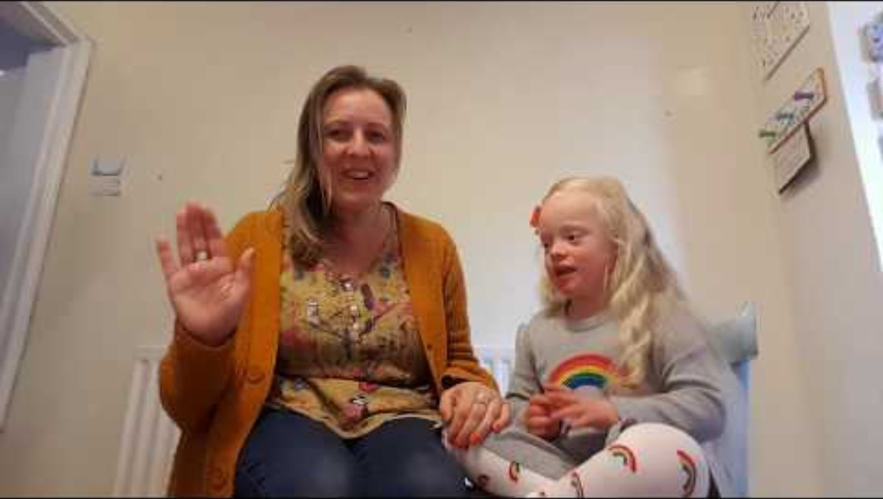
W/B 15.04.24 - Find

Slide 30
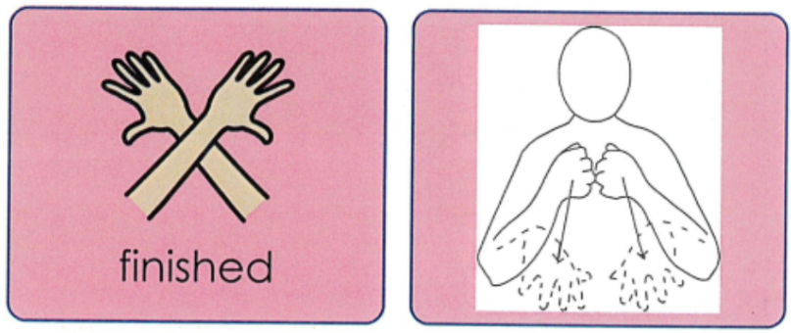
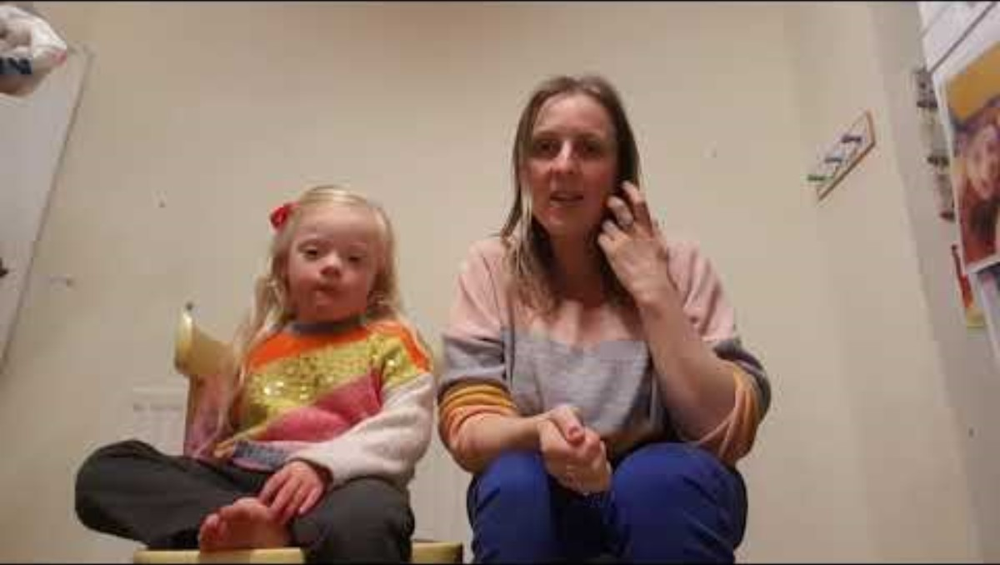
W/B 22.04.24 - Finish

Slide 31
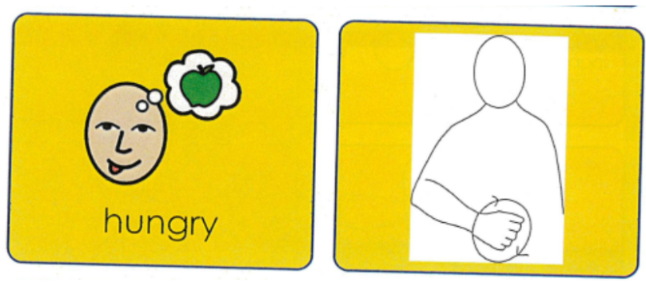
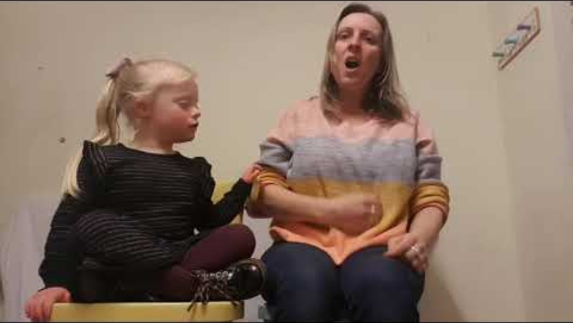
W/B 29.04.24 - Hungry

Slide 32
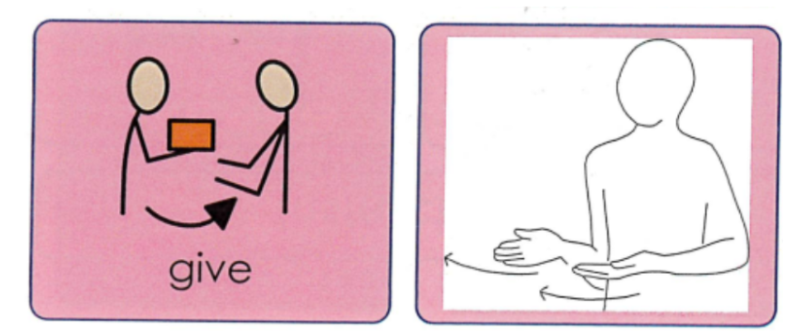
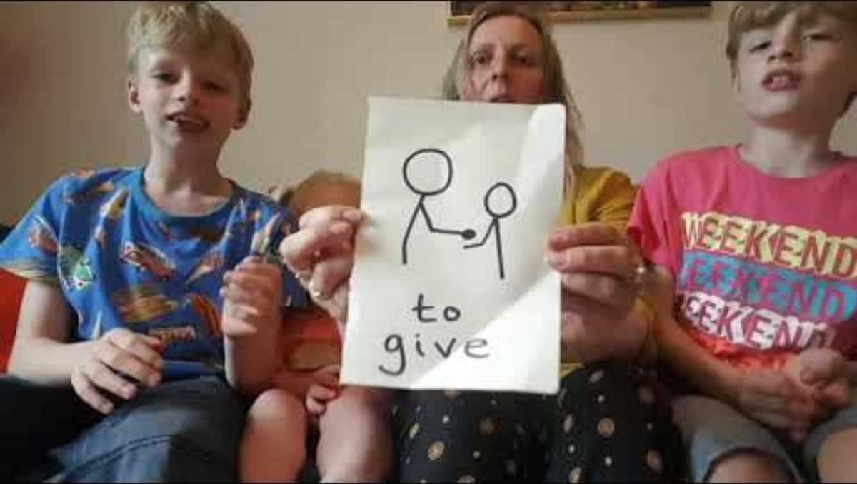
W/B 07.05.24 - Give

Slide 33

W/B 13.05.24 - Want

Slide 34
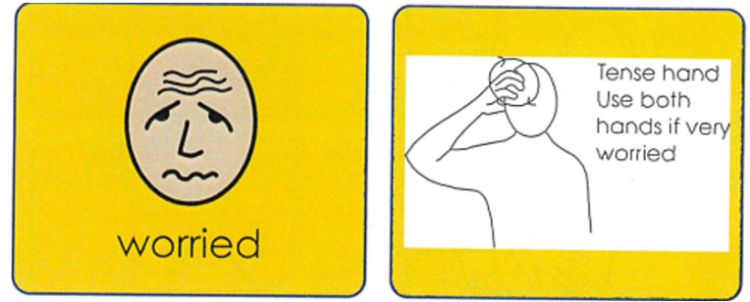
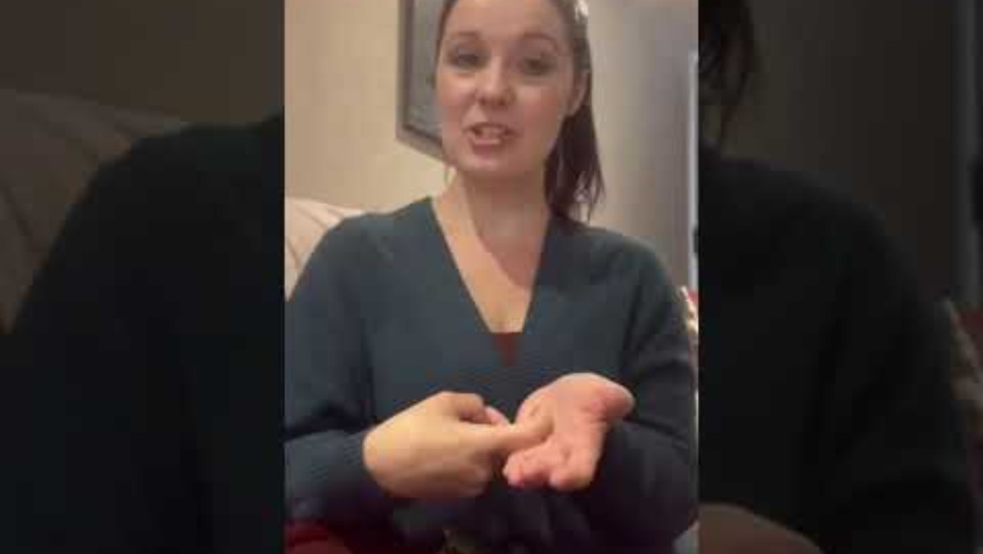
W/B 20.05.24 Worried -

Slide 35
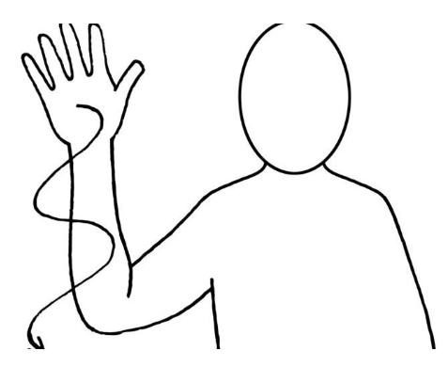
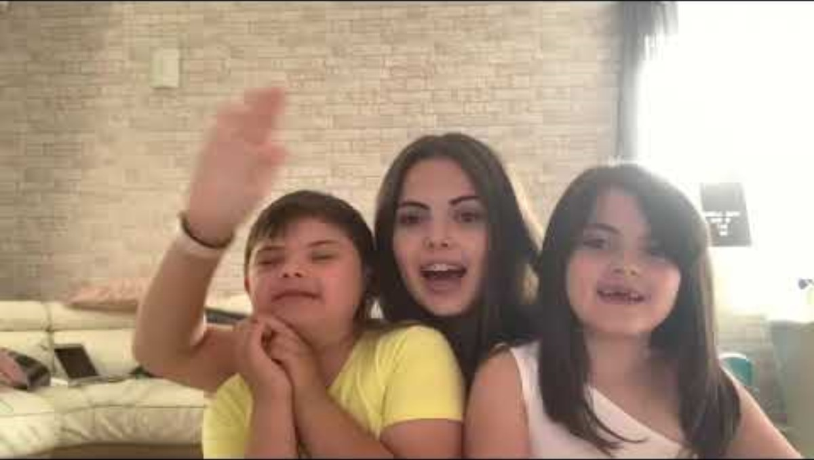
W/B 03.06.24 - Colour

Slide 36
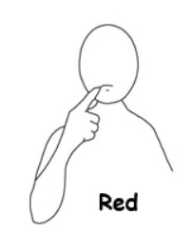
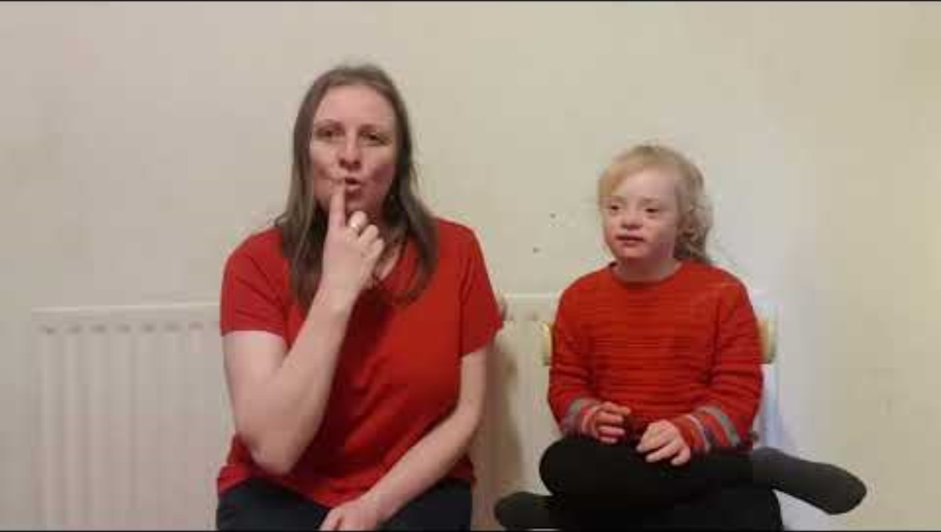
W/B 10.06.24 - Red

Slide 37


W/B 17.06.24 - Blue

Slide 38


W/B 24.06.24 - Green

Slide 39


W/B 01.07.24 - Orange

Slide 40


W/B 08.07.24 - Purple

Slide 41

W/B 15.07.24 Rainbow

Slide 42


W/B 09.09.24 - School

Slide 43


W/B 16.09.24 - Teacher

Slide 44

W/B 23.09.24 - How are you?

Slide 45


W/B 30.09.24 - Happy

Slide 46


W/B 07.10.24 - Sad

Slide 47
W/B 14.10.24 - Hungry

Slide 48


W/B 21.10.24 - Autumn

Slide 49


W/B 04.11.24 - Who?

Slide 50


W/B 11.11.24 - What?

Slide 51


W/B 18.11.24 - When?

Slide 52


W/B 25.11.24 - Why?

Slide 53


W/B 03.12.24 - How?

Slide 54


W/B 09.12.24 - Christmas

Slide 55


W/B 16.12.24 - Snow

Slide 56


W/B 06.01.25 - Table

Slide 57


W/B 13.01.25 - Chair

Slide 58


W/B 13.01.25 - Sit

Slide 59


W/B 27.01.25 - Stand

Slide 60


W/B 03.02.25 - Help

Slide 61


W/B 10.02.25 - More

Slide 62

W/B 24.02.25 - Give

Slide 63

W/B 03.03.25 - Finished

Slide 64


W/B 10.03.25 - Draw

Slide 65


W/B 17.03.25 - Write

Slide 66


W/B 24.03.25 - Read

Slide 67

W/B 31.03.25 - Work

Slide 68


W/B 22.04.25 - Easter

Slide 69


W/B 28.04.25 - Spring
https://youtu.be/9TzjeWav2VE?si=xYXObs0NlReeZraq

Slide 70


W/B 06/05/25 - Suncream

Slide 71


W/B 12.05.25 - Ice Cream

Slide 72


W/B 19.05.25 - Hot

Slide 73


W/B 02.06.2025 - Happy

Slide 74

W/B 09.06.2025 - Frustrated/Angry

Slide 75


W/B 16.06.2025 - Calm

Slide 76


W/B 23.06.2025 - Worried

Slide 77


W/B 30.06.2025 - Beach

